Slide 1
SMART Home
Group 2:
John Satterla – Computer Engineer – Wireless Connectivity
Zachary Eakerns – Electrical Engineer – Biomedical Station
Zarka McClung – Computer Engineer – Facial Recognition
Christian Jensen [Team Lead] – Electrical Engineer – Voice Recognition

Slide 2

Last Week's Deliverables
John Satterla
Zachary Eakerns
Zarka McClung
Christian Jensen
Start integrating GUI's
Start interfacing devices
Improve accuracy of location detection
Have python graphing the ADC in real time
Make headway on circuit instability
Write Python code to send serial communication to Zigbee
Establish motor code
Finish green board design
Continue writing Matlab code for voice recognition

Slide 3
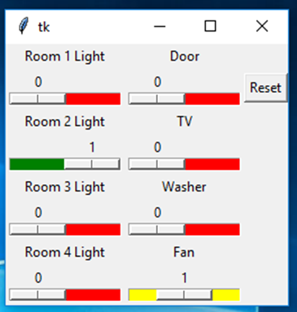
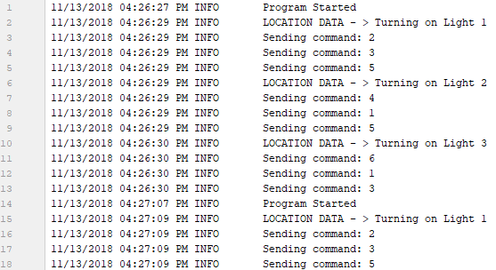
Graphical User Interface – More Development
Using Python 3, with TkInter as GUI, and pyserial for communication to USB dongle with XBee module
Added logging so we can debug somewhere other than the command line, and logging will also be useful for users
Current GUI for Control and monitoring of devices
Log for yesterday, creates a new log for each day

Slide 4

Graphical User Interface – Demo
GUI allows control and can receive updates (for instance if door is trigger by facial recognition, or voice recognition receives command)
Notes:
https://www.youtube.com/watch?v=b2MJs8F0EOw&feature=youtu.be

Slide 5
Location Detection
TI got back to me, they had me change the setting I was using.
Now, instead of using the “Auto ToF” mode, using “Connected ToF”
Connected ToF allows for more packets to be sent at a higher rate, therefore increasing accuracy
TI tells me that this is designed for specifically ToF applications, while Auto was designed to interleave with a standard Bluetooth Connection
Tell me that antenna’s should be facing each other and calibration at 1m is extremely important
Increasing the syncwords (what I tried last week) was making the RAM overflow because of how much was being stored while sending and receiving the additional packets. Each syncword added adds 8 bytes of RAM usage on both the initiator and receiver
Results are MUCH improved. Fewer negatives and connection is maintained across much longer distances
Examples on next slide
Will tinker with adding syncwords to see if accuracy is improved without overloading RAM

Slide 6
Location Detection – Processing in Python
Currently able to reliably distinguish between 0-3m, 3-6m, and 6-10m. This would be good, but want to increase accuracy by testing in environment where demoing (basement hallway probably)
Actual accuracy of ToF
Calibration has to occur each time the program starts, with each LaunchPad 1 meter away
Within 1-2m for each ToF measurement taken, giving me the 3-4m intervals for each “room”
Current processing algorithm in Python:
1. Take each measurement and place into an array of 10 measurements (first in, first out), call this measurementArray
2. Take the average of the measurementArray
3. Add this average to another array of 10 previous averages called averageArray, also (first in, first out)
4. Take the average of the last 10 averages (basically last 100 measurements taken)
5. Send the averaged value to the checkLocation function

Slide 7
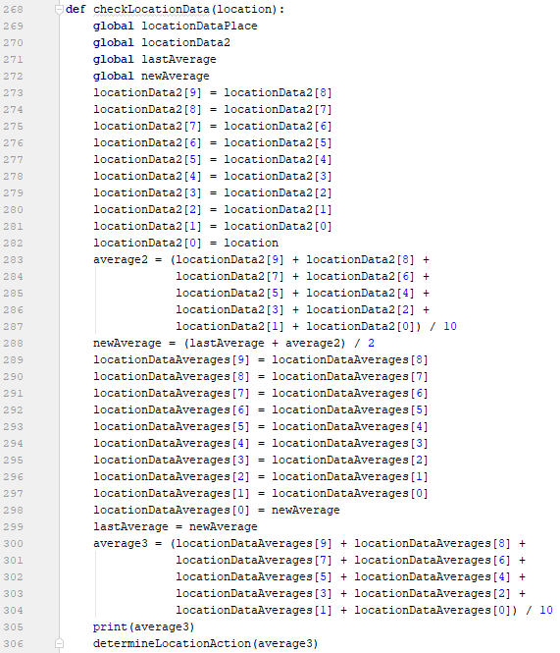
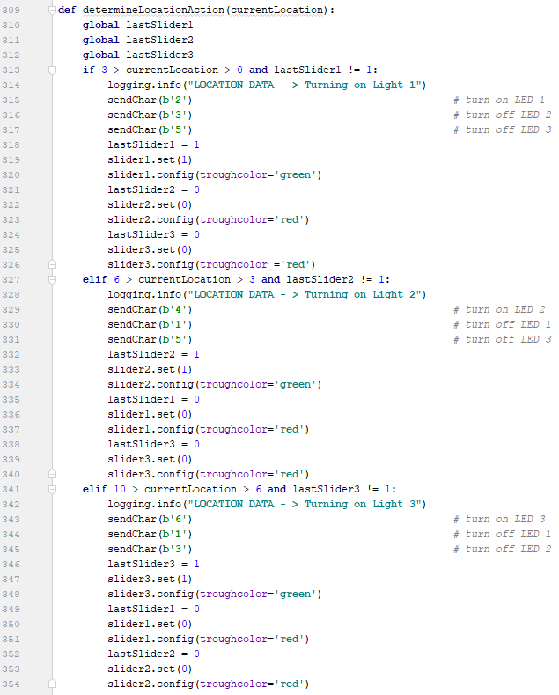
Location Detection – Processing in Python

Slide 8
Location Detection – Integrated with GUI and Zigbee Networking
Notes:
https://www.youtube.com/watch?v=ADMcdPN37zU

Slide 9
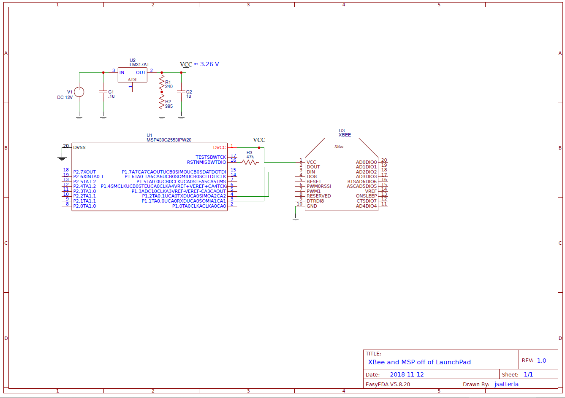
MSP off Launchpad Testing - Schematic

Slide 10
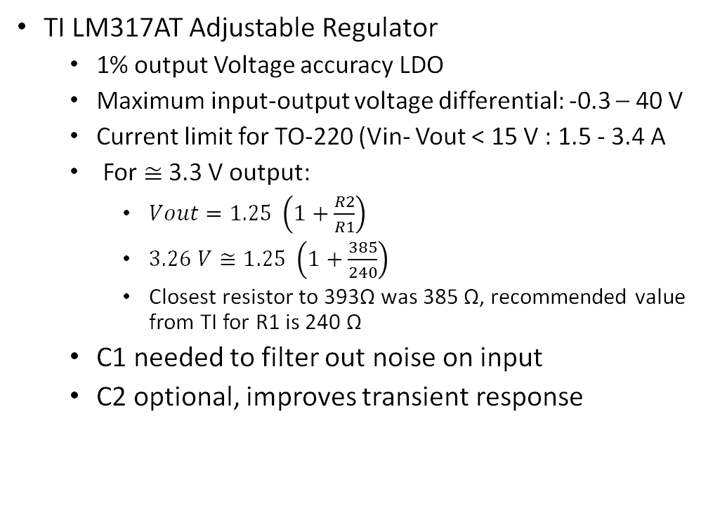
MSP off Launchpad Testing - LM317AT
TI LM317AT Adjustable Regulator
1% output Voltage accuracy LDO
Maximum input-output voltage differential: -0.3 – 40 V
Current limit for TO-220 (Vin- Vout < 15 V : 1.5 - 3.4 A
For $≅$ 3.3 V output:
$Vout=1.25 \left(1+\frac{R2}{R1}\right)$
$3.26 V≅1.25 \left(1+\frac{385}{240}\right)$
Closest resistor to 393Ω was 385 Ω, recommended value from TI for R1 is 240 Ω
C1 needed to filter out noise on input
C2 optional, improves transient response

Slide 11
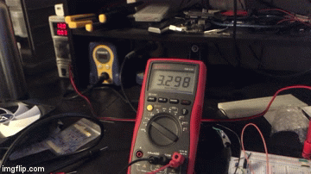
MSP off Launchpad Testing - LM317AT
TI LM317AT Adjustable Regulator
1% output Voltage accuracy LDO
Maximum input-output voltage differential: -0.3 – 40 V
Current limit for TO-220 (Vin- Vout < 15 V : 1.5 - 3.4 A
For $≅$ 3.3 V output:
$Vout=1.25 \left(1+\frac{R2}{R1}\right)$
$3.26 V≅1.25 \left(1+\frac{385}{240}\right)$
Closest resistor to 393Ω was 385 Ω, recommended value from TI for R1 is 240 Ω
C1 needed to filter out noise on input
C2 optional, improves transient response
Within 1% error and no detectable ripple

Slide 12
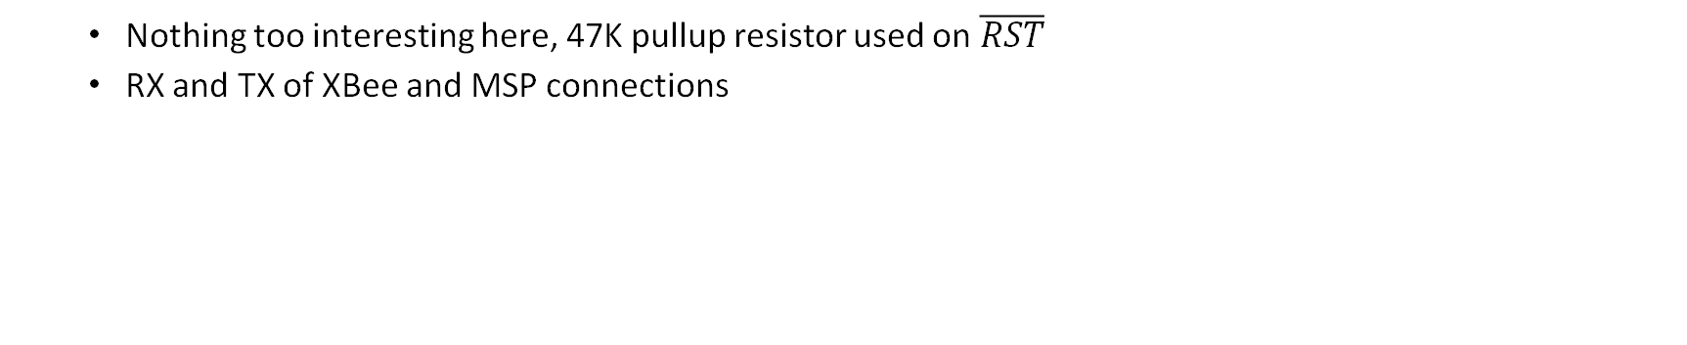
MSP off Launchpad Testing - Schematic
Nothing too interesting here, 47K pullup resistor used on $\overline{RST}$
RX and TX of XBee and MSP connections

Slide 13
MSP off Launchpad Testing - Video
Simple Echo program from XBee command line
Notes:
https://www.youtube.com/watch?v=3BMpv4auUMM

Slide 14
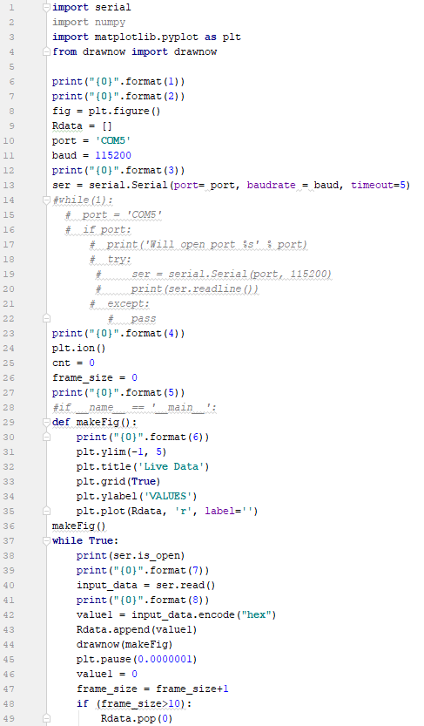
Python Code
The definition function in Python code was unreachable, causing error
To fix this, the line makeFig() was added telling python to enter the definition

Slide 15
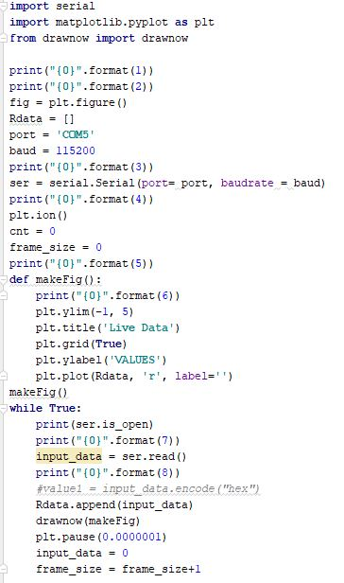
Python Code Continued
Encode function was causing error each time code was run
Removing this allowed for the graph to work

Slide 16
Code Composer Studio Code
Bloated due to many changes, revisions, and commented out sections
Made code more difficult to read and debug
The bulk of the error is likely to happen in this program, so a clean and readable version was needed

Slide 17
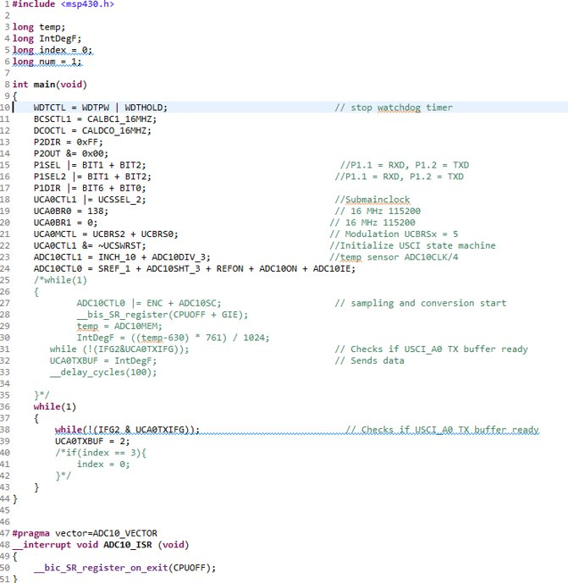
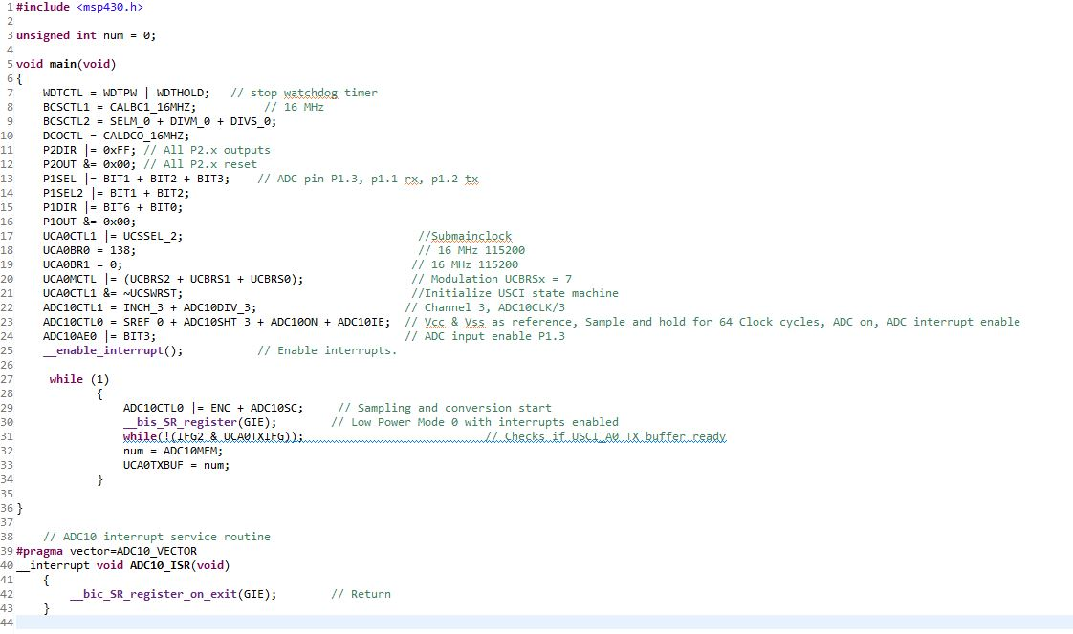

Slide 18
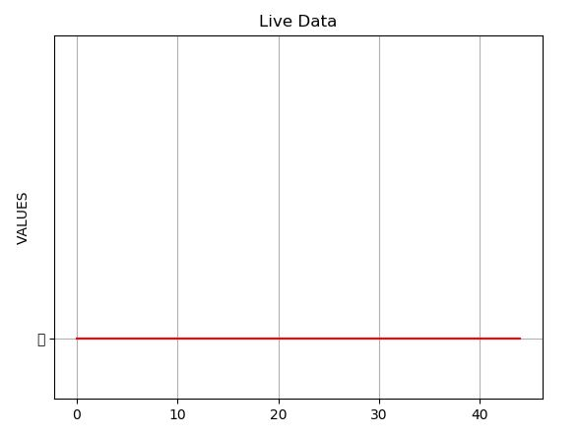
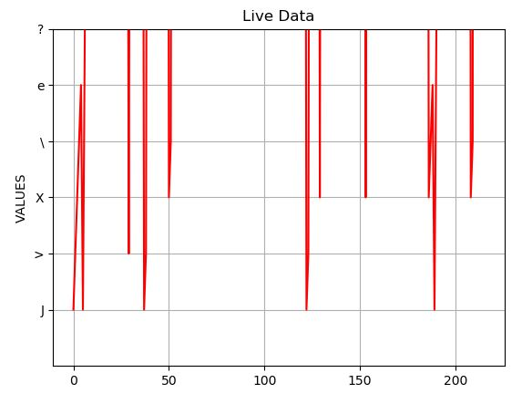

Slide 19
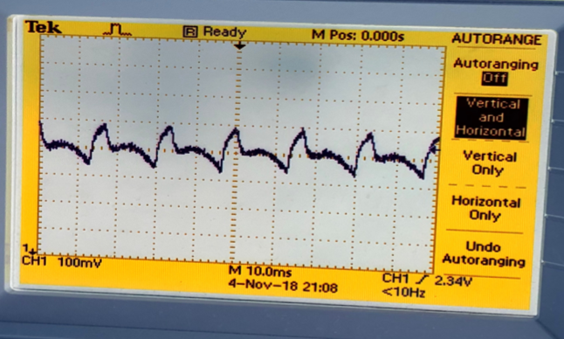
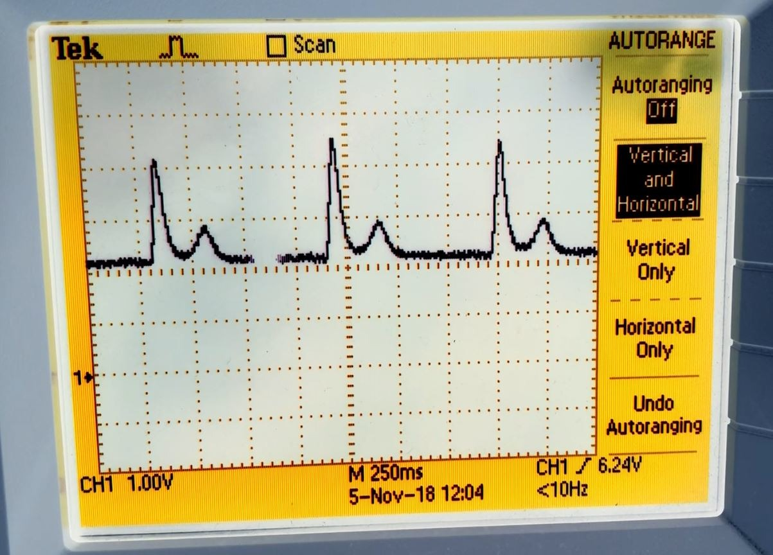
Circuitry
With artifact
Without artifact

Slide 20
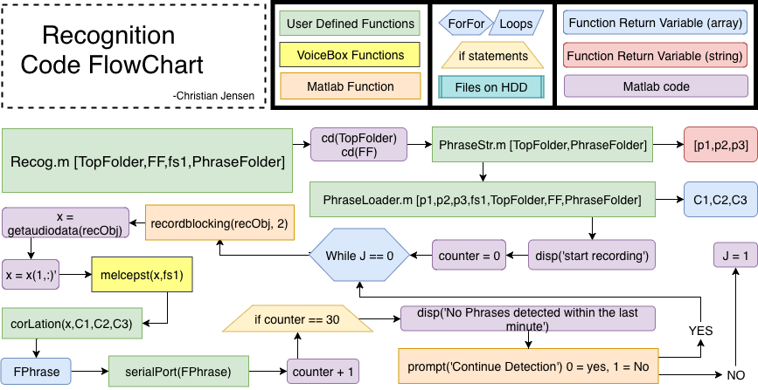

Slide 21
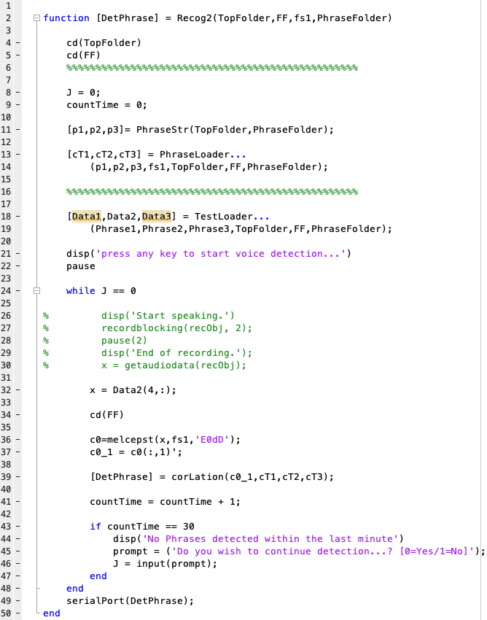

Slide 22
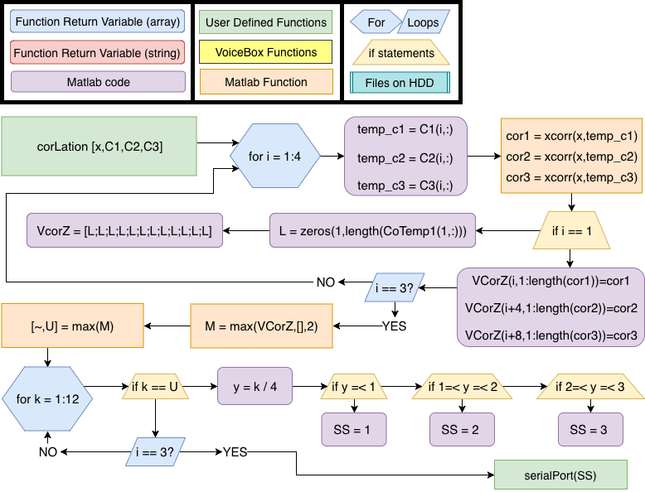

Slide 23
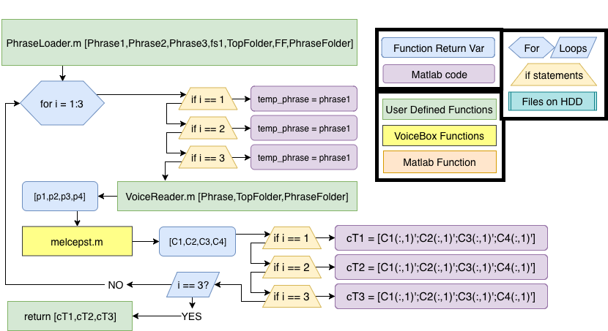

Slide 24
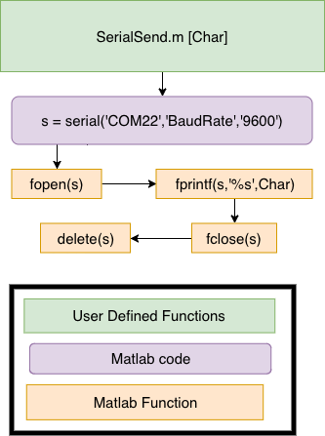
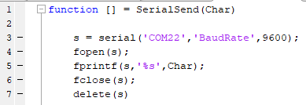

Slide 25
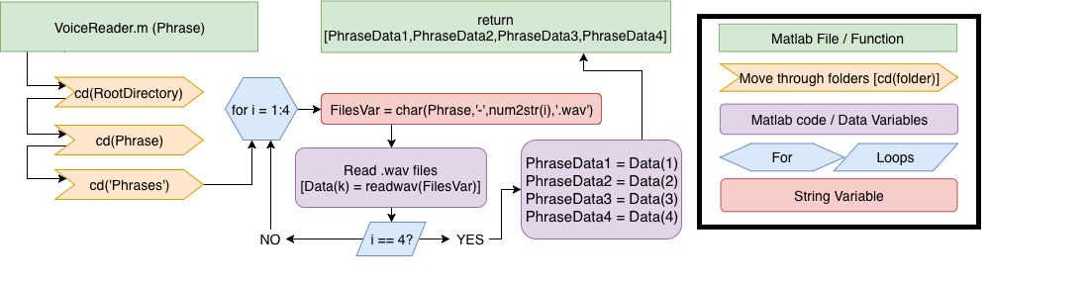
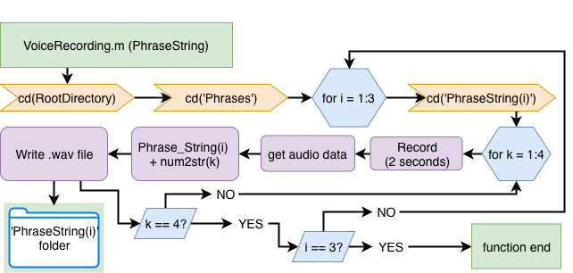

Slide 26
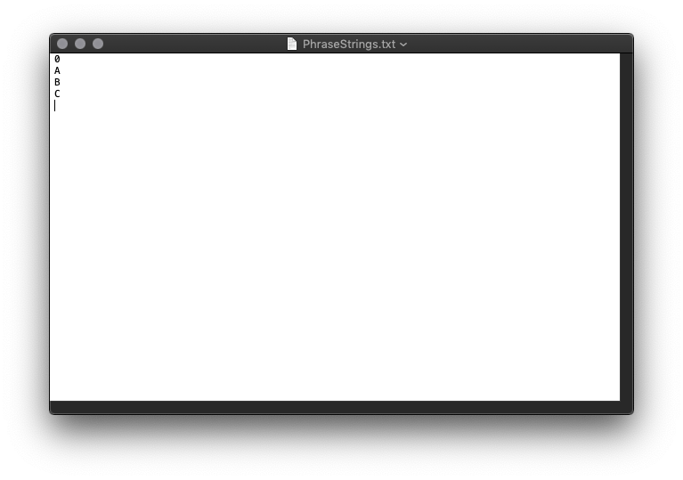
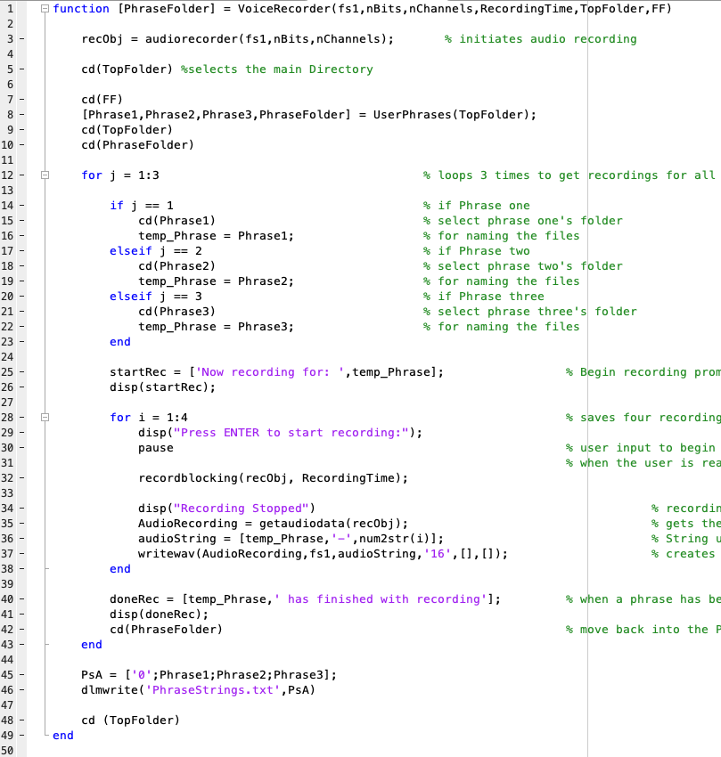
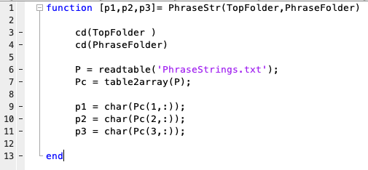
Phrase String Table example

Slide 27
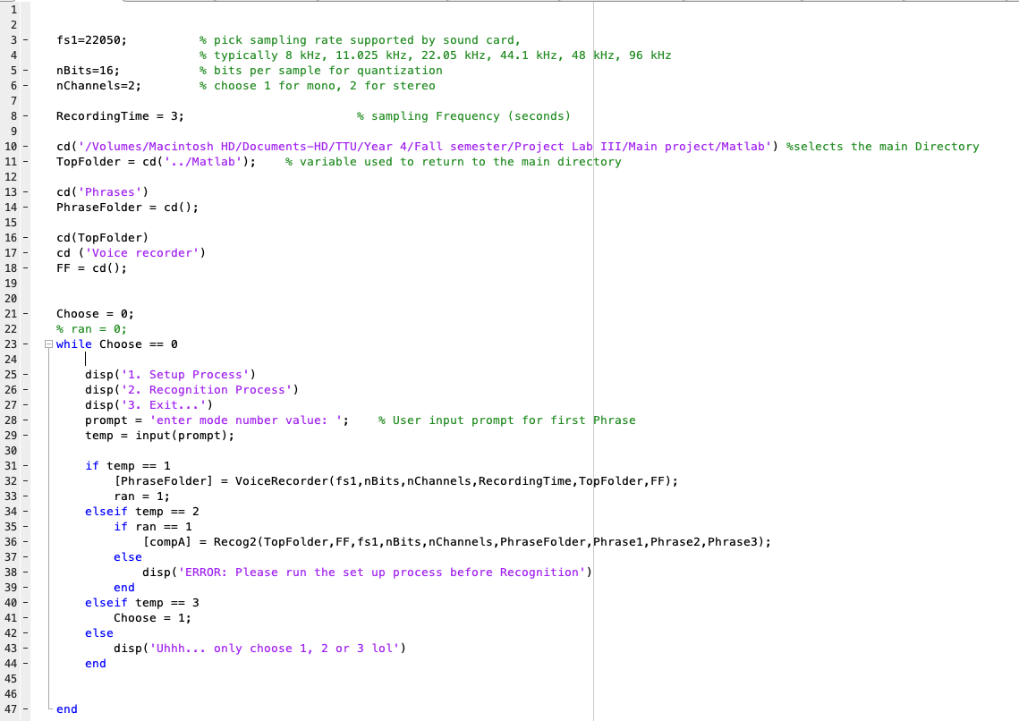

Slide 28
Demo Screen Recording of Recognition
https://youtu.be/yX46B4Bykhw

Slide 29
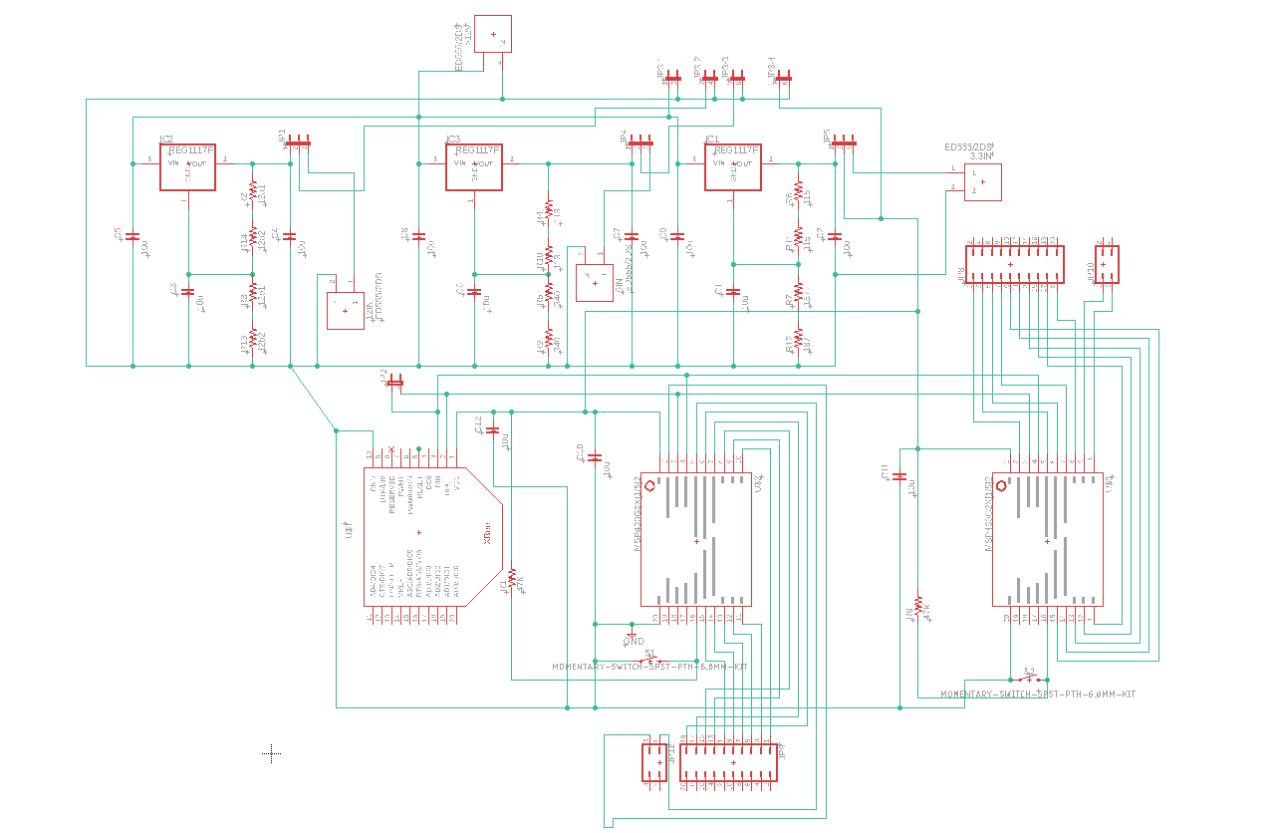
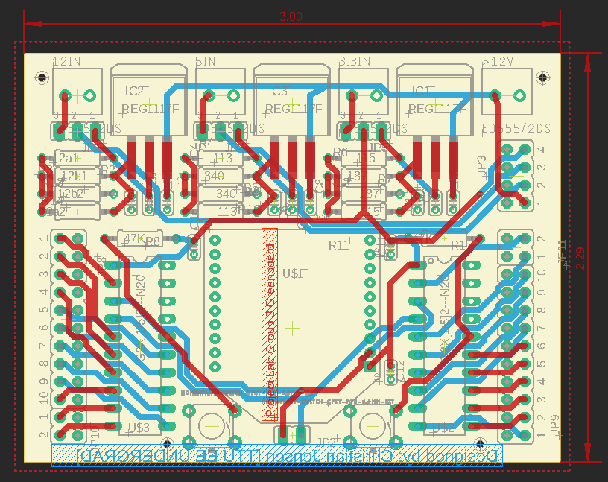
Green Board Design
2 MSP paired with an XBee Module
2x MSP430G IC
3x regulators
All REG1117 adjustable LDOs [1]
1 A output (max)
3.3V,5V,12V
XBee Module on header pins
Design done in Eagle Cad

Slide 32
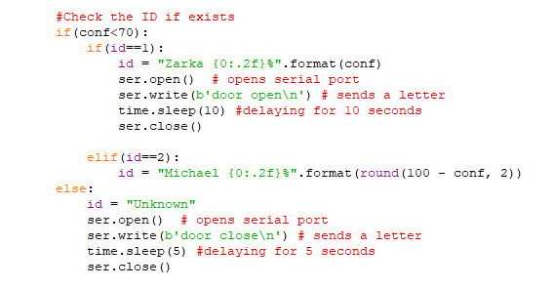
Code changes
Ser.write -> sends one char
Need a delay to send all characters "open"/"close"
Plan is to assign A = door open B= door close

Slide 33
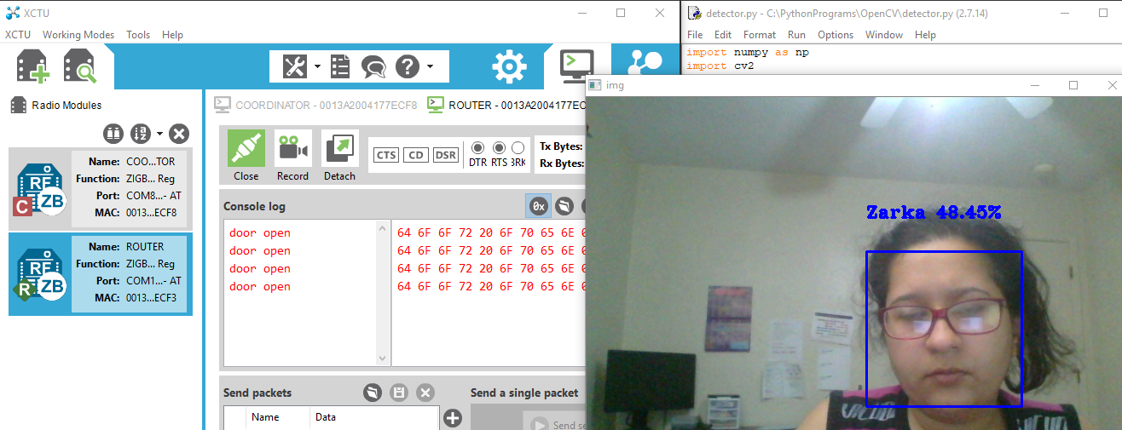
Door open

Slide 34
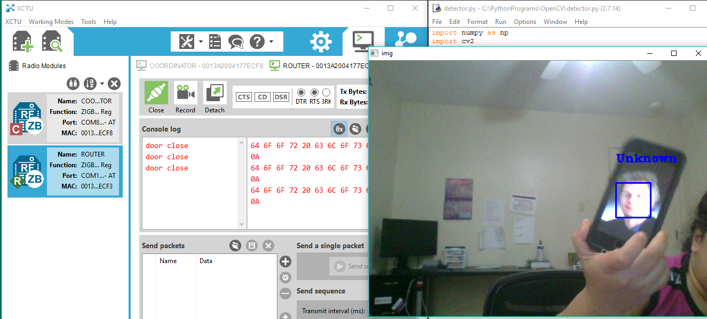
Door close

Slide 35
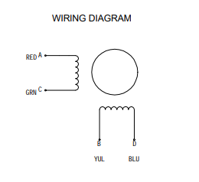
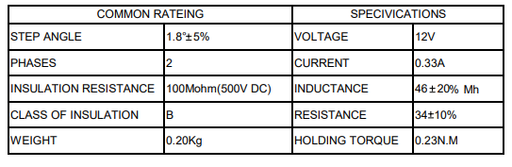
NEMA 17 SM-42BYG011-25 stepper motor
[2]
Current needed for easy driver:
2A (max)
Voltage needed:
6V – 30V
Around 200 steps for 1 rev

Slide 36
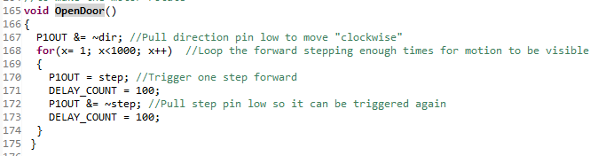
MSP430G2553 with Stepper
Connection setup
A == Green
A_N == Red
B == Blue
B_N == Yellow
STEP -Logic Input. Triggers the motor to step forward one step.
DIR -Logic Input. Determines the direction of motor rotation.

Slide 37
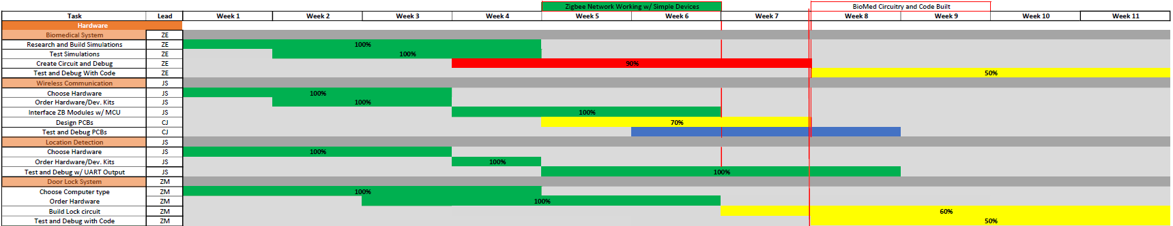
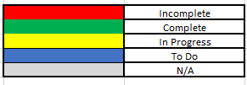
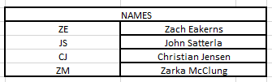
Gantt Chart

Slide 38
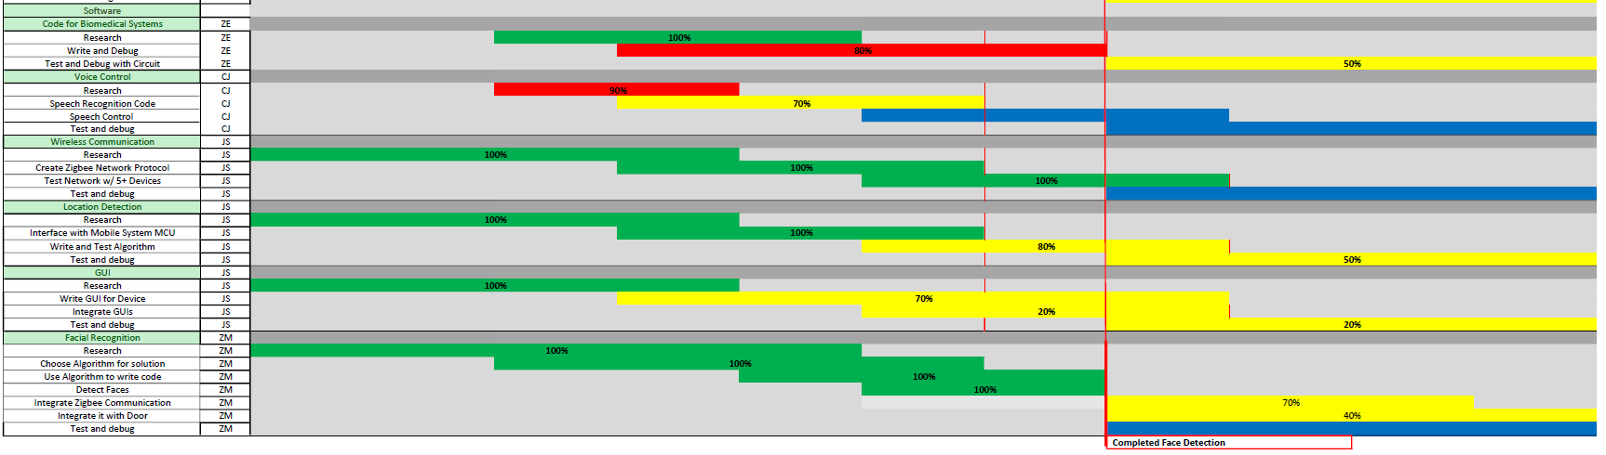
Gantt Chart

Slide 39
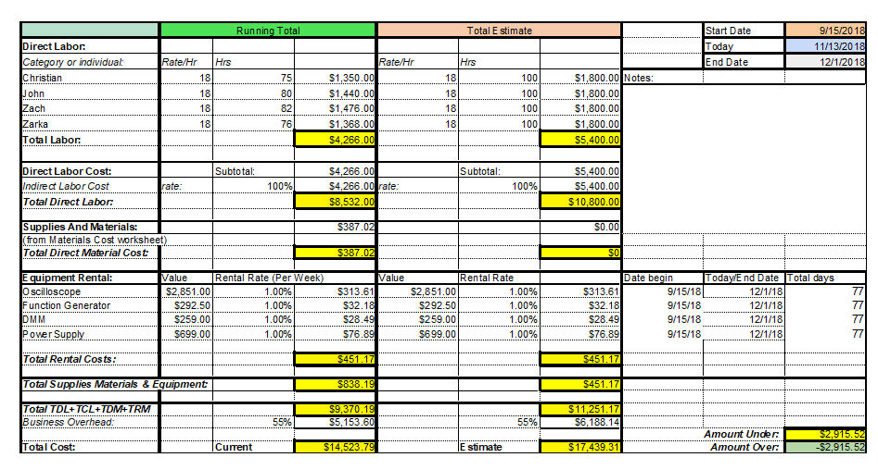
Budget

Slide 40
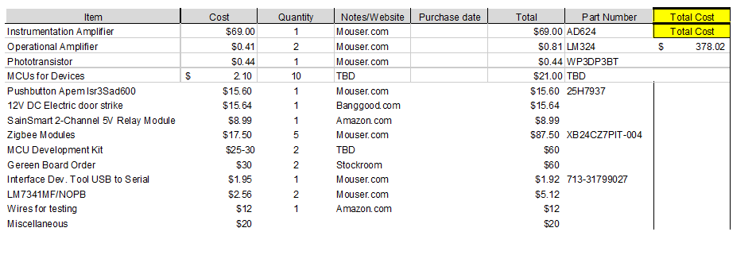
Material Cost

Slide 41
Next Week's Deliverables
John Satterla
Zachary Eakerns
Zarka McClung
Christian Jensen
Get OLED display and computer fan integrated with MSP
Integrate GUI fully, and add an option to turn off ToF and turn in back on
House built
All circuitry off breadboard and integrated with code to display EKG graph in real time
Code TX/RX of MSP
Finalize motor code upon signal from Zigbee coordinator
Finalize code for MATLAB serial communication
Order green board

Slide 42
References
“REG1117A (ACTIVE),” REG1117A 1A Low Dropout Positive Regulator | TI.com. [Online]. Available: http://www.ti.com/product/REG1117A. [Accessed: 07-Nov-2018].
K, T. (2018). Easy Driver Hook-up Guide. [online] Available at: https://learn.sparkfun.com/tutorials/easy-driver-hook-up-guide [Accessed 14 Nov. 2018].

Slide 43
Questions?

